Slide 1

Your Next Best Restaurant
Building a Recommendation Engine Using Neural Network
ATHENS UNIVERSITY OF ECONOMICS AND BUSINESS | MSc IN BUSINESS ANALYTICS

Slide 2



Business Intelligence Team @ YELP,
an American public company that publishes crowd-sourced reviews about businesses.
Vasileios Kotsomytis,
BI Analyst
billkotsomitis@gmail.com
Efstratios Romanidis,
BI Analyst
efstratiosromanidis@gmail.com
Athina Spanou,
BI Analyst
athispanou@gmail.com

Slide 3





Mission
To build a personalized Restaurant Recommendation Engine based on a user’s reviews
210K Unique Businesses
2M Unique Users
8M Unique Business Reviews
10GB of unprocessed data

Slide 4


Natural Language Processing
Reviews and Cuisine Categories
Lower Text
Remove non-English words
Replace contractions
Remove punctuations
Convert accented characters
Remove Whitespace
Tokenization
Remove Stopwords
Lemmatization

Slide 5
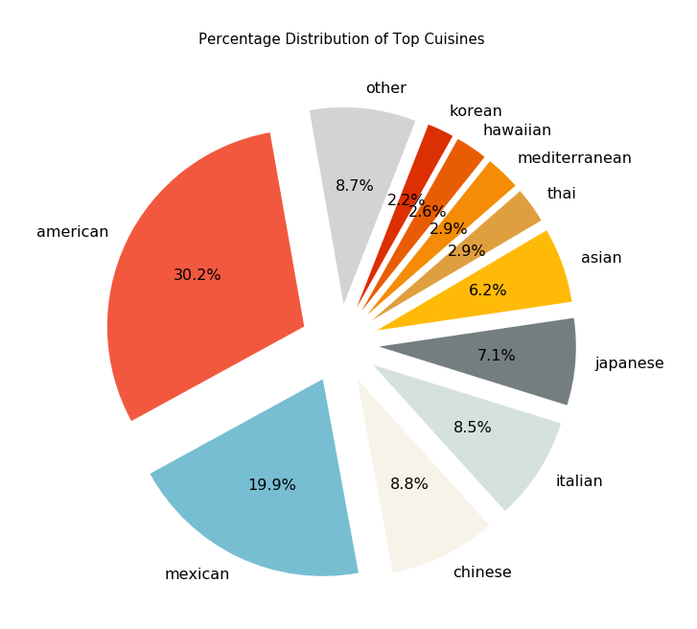
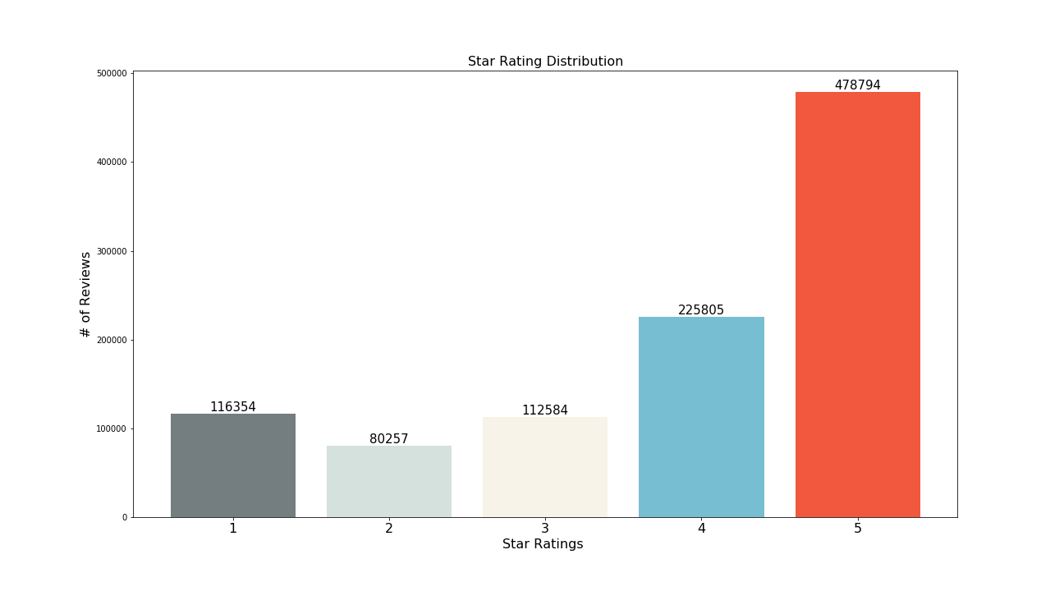
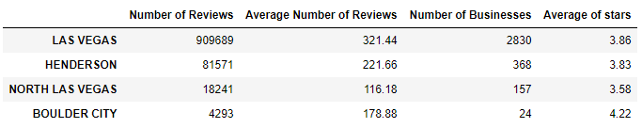
Exploratory Data Analysis

Slide 6
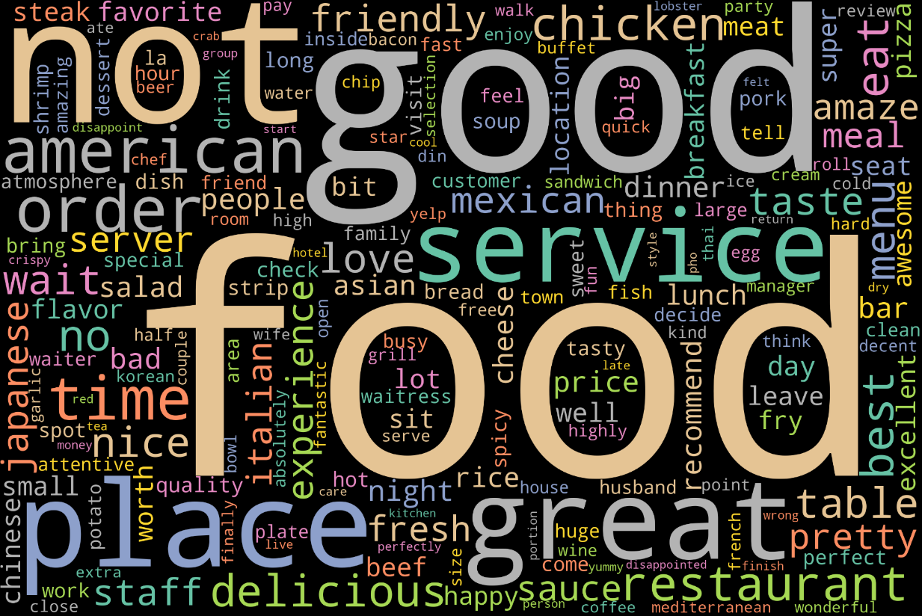

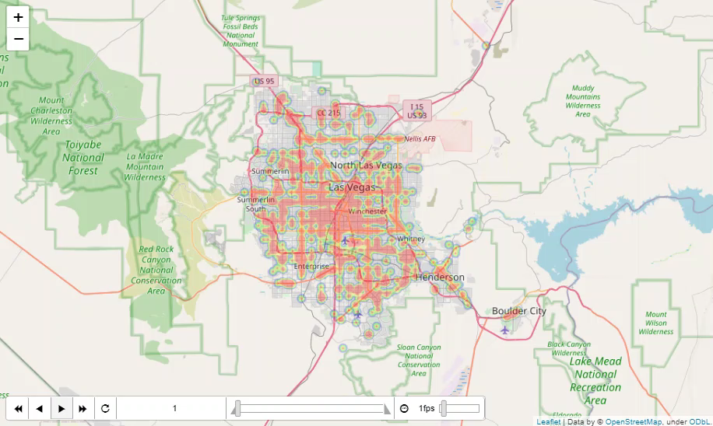
Word-Cloud Most Frequent Words in Reviews
HeatMap Nevada X Rating Stars

Slide 7

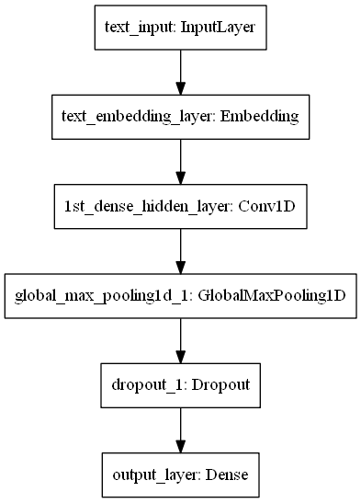
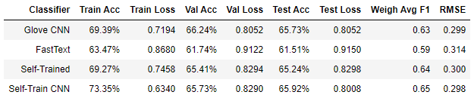
Neural Network Models
Train & Evaluate 4 different Models
CNN using pre-trained Glove Embeddings
MLP using pre-trained Fast-Text Embeddings
MLP Using Self-Trained Embeddings
CNN Using Self-Trained Embeddings

Slide 8
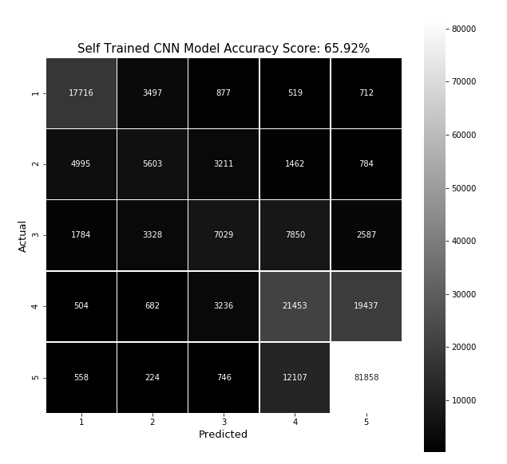
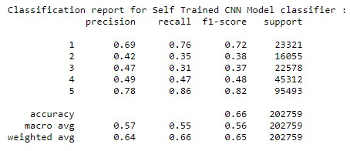

Confusion Matrix & Classification Report
Model

Slide 9

Recommendation Engine
Find Similar Reviews
Extract weights from the best model
Select a user with at least a review
Sort by rating stars and keep the most recent review
Find similar reviews using cosine similarity
Return the restaurant that matches the preferences of the user

Slide 10
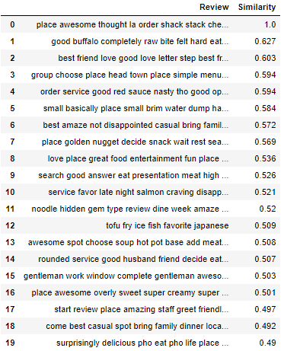
Input
Review
« place awesome thought order shack stack cheese man not disappoint mushroom act patty stuffed cheese fry wow unbelievable husband perfect good coffee chocolate mint winner chicken dinner eat lunch day not disappoint american »

Slide 11
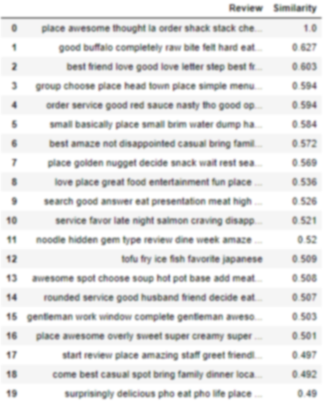
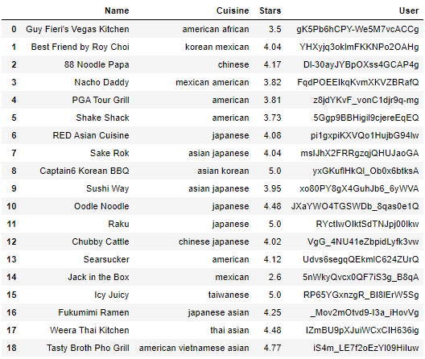
Input
Review
« place awesome thought order shack stack cheese man not disappoint mushroom act patty stuffed cheese fry wow unbelievable husband perfect good coffee chocolate mint winner chicken dinner eat lunch day not disappoint american »

Slide 12
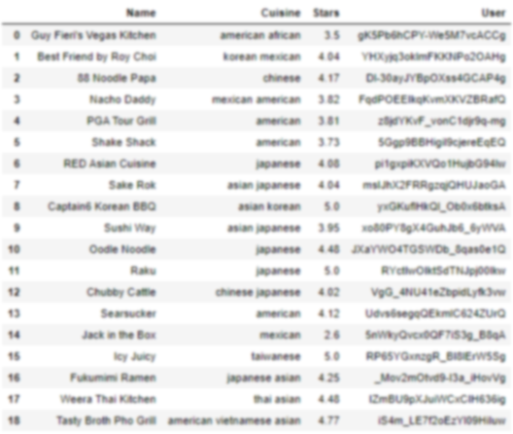
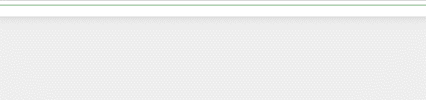
Input
Review
« place awesome thought order shack stack cheese man not disappoint mushroom act patty stuffed cheese fry wow unbelievable husband perfect good coffee chocolate mint winner chicken dinner eat lunch day not disappoint american »

Slide 13
Thank you !
… and have a nice meal!

